Slide 1
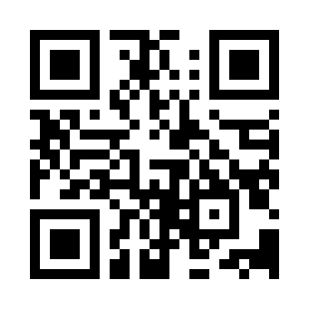

Software Project Monitoring and Control Quiz
https://bit.ly/3rfa9f8

